Slide 1
1 of 3 Projects Part 1: Lightning Talk
Avi Raj
General Assembly, Atlanta
March 2016

Slide 2
Global Warming/Climate Change (Real threat or dodgy science)
Kaggle dataset put together through long-term study of climate trends – courtesy Berkley Earth.
The Berkeley Earth Surface Temperature Study combines 1.6 billion temperature reports from 16 pre-existing archives.
Bias in data - Early data was collected by technicians using mercury thermometers, where any variation in the visit time impacted measurements. In the 1940s, the construction of airports caused many weather stations to be moved. In the 1980s, there was a move to electronic thermometers that are said to have a cooling bias.
Hypotheses: Null – Climate trends have remained the same with time
Alternative – Climate trends have changed with time

Slide 3
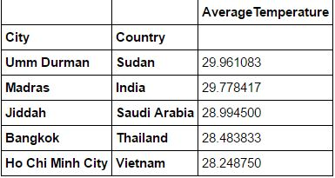
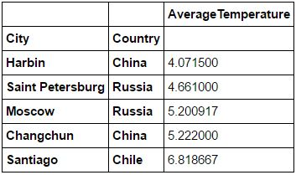
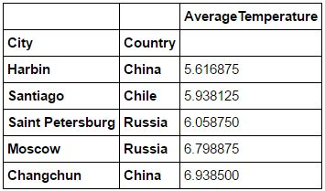
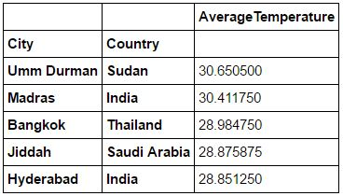
Five hottest major cities of 2012
Five coldest major cities of 2012
Five hottest major cities of 2013
Five coldest major cities of 2013

Slide 4
Chances of surviving the Titanic crash
Not enough lifeboats.
Element of luck but also predictability – women, children and upper-class more likely to survive
Variables – survival ( 0 or 1), name, passenger class (1st, 2nd or 3rd), sex, age, # siblings/spouses on board, #parents/children on board, port of boarding, ticket identification, ticket price.
What would success look like?
- to be able to assign the right probabilities for survival of different categories of passengers

Slide 5
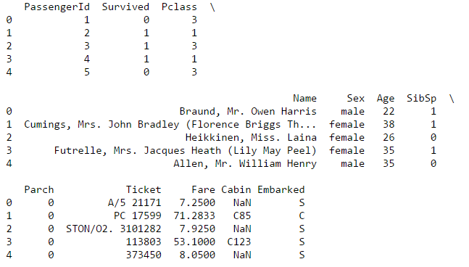
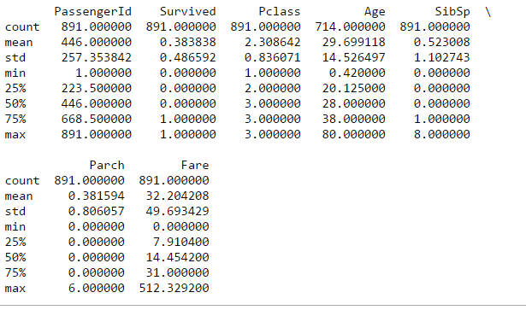
.head()
.describe()

Slide 6
Testing search relevance at Home Depot
Important factors: speed (quick results and accuracy (correct results)
“Currently, human raters evaluate the impact of potential changes to their search algorithms, which is a slow and subjective process. By removing or minimizing human input in search relevance evaluation, Home Depot hopes to increase the number of iterations their team can perform on the current search algorithms.”
Data set (train) contains number of products and real customer search terms from H.D.’s website, along with relevance score (1 –not relevant, 3 – highly relevant)
Variables – id, product_uid, product_title, search_term, relevance
Success – Predict relevance for pairs in Test data set.

Slide 7
